Slide 1
OASE
What do you see? What do you know? What is happening?

Slide 2
Steps
Observe: Write down all the observations you see. It can be very simple, but really important.
Analyze: What connections do can you make? What does it remind you of?
Speculate: Guess as to what is going on, where it might be happening, and when it might be happening.
Evaluate: We will go over the answers and see what is right.

Slide 3
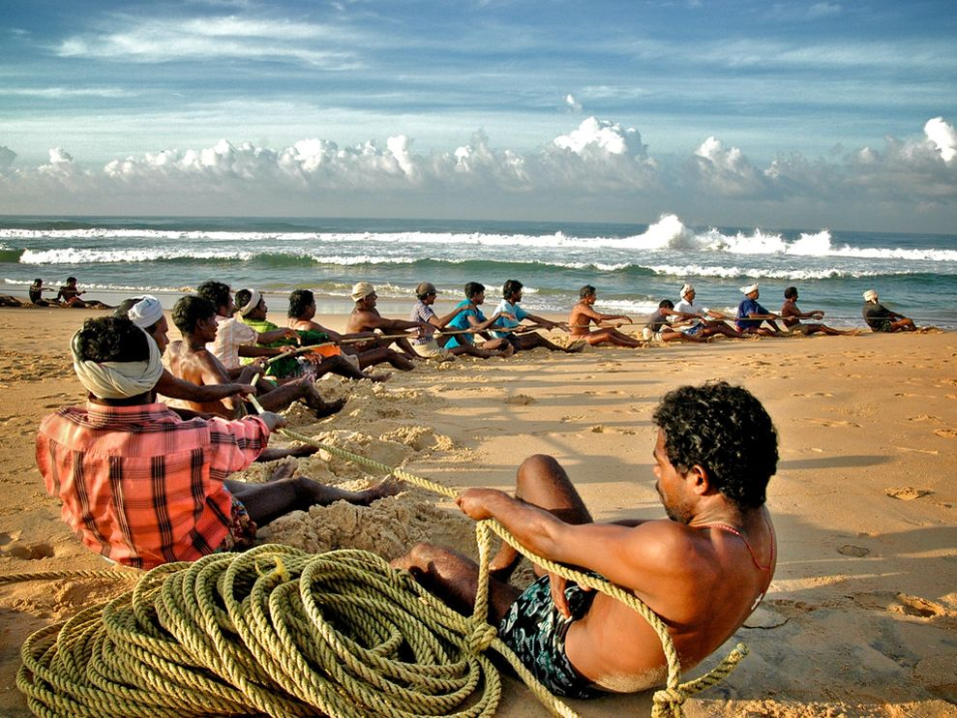
Picture #1

Slide 4
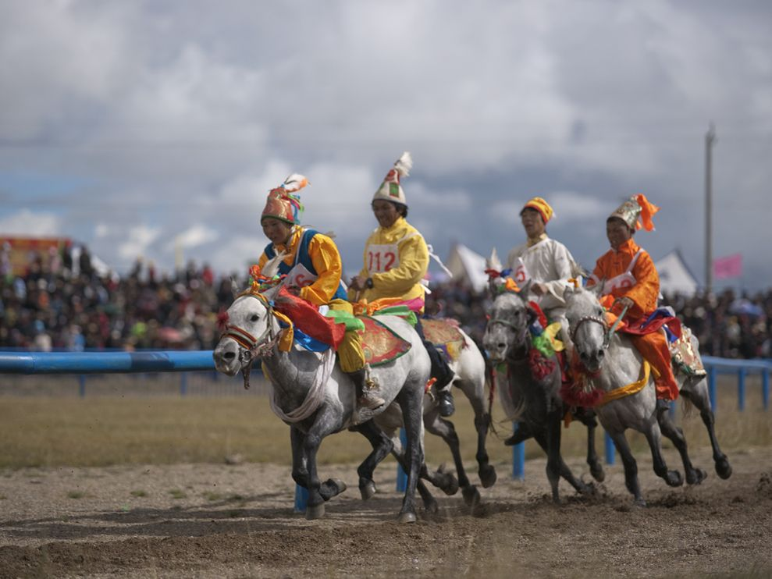
Picture #2

Slide 5
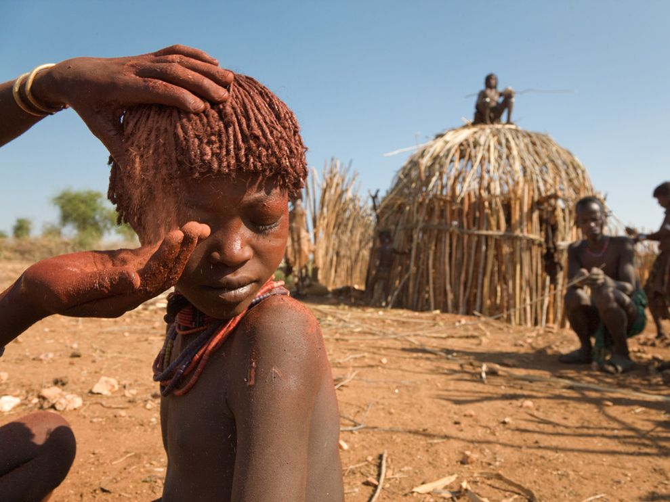
Picture #3

Slide 6
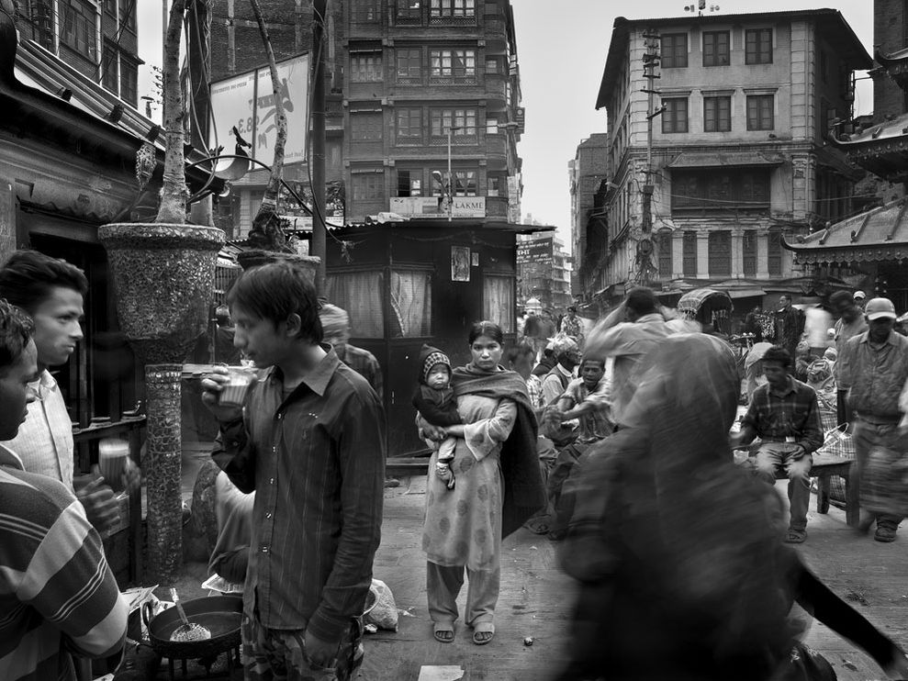
#4

Slide 7
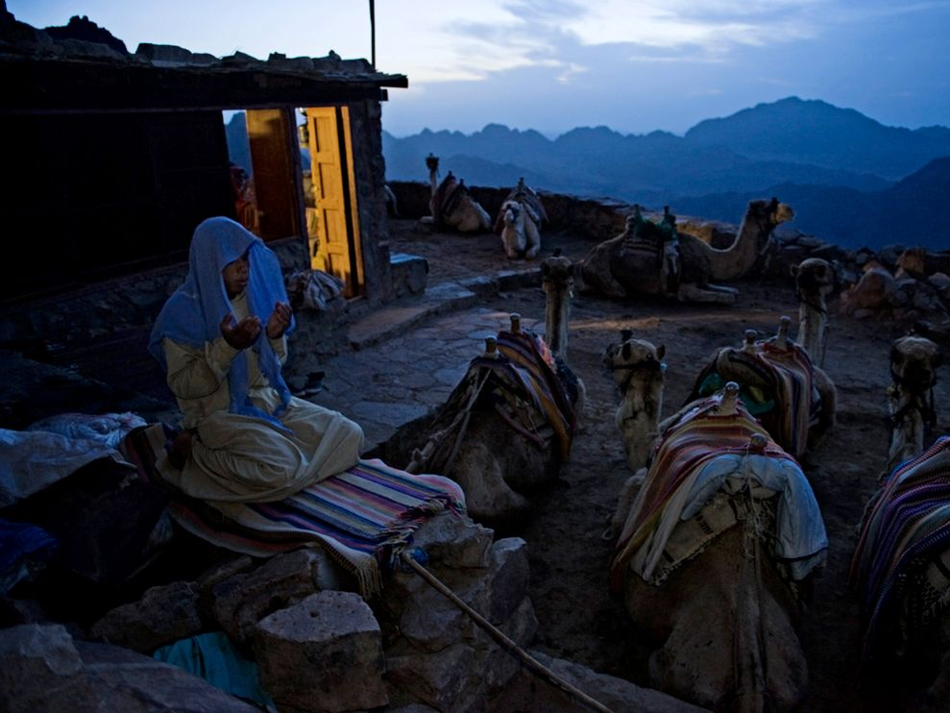
#5

Slide 8
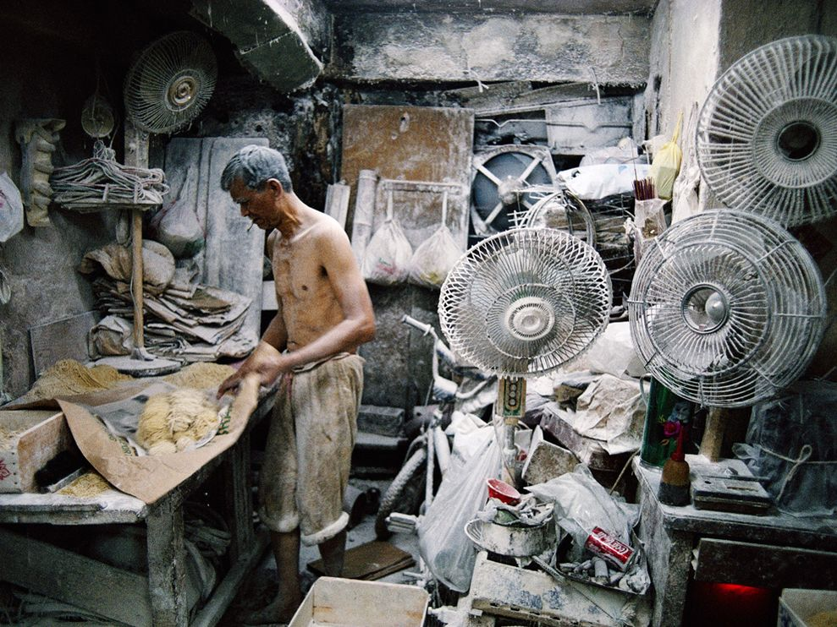
#6

Slide 9
Answers
#1: Fishermen in India
#2 Teenagers racing at a horse festival in Tibet
#3 Dying hair in Ethiopia
#4: Crowded streets in Kathmandu, Nepal
#5 Muslim praying at Mount Sinai, Egypt
#6 Noodle maker in Hong Kong

