Slide 1
Erosion Forces
Wind, Water, Waves, and Ice

Slide 2
External Forces
These erosion forces are external, meaning they happen on the outside of the land
Wind
Water-Rivers, streams, etc
Waves-Oceans mainly
Ice-Glaciers and Snow

Slide 3
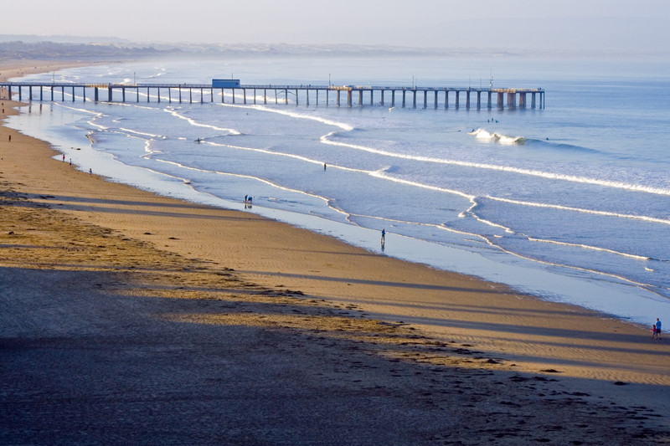

Slide 4
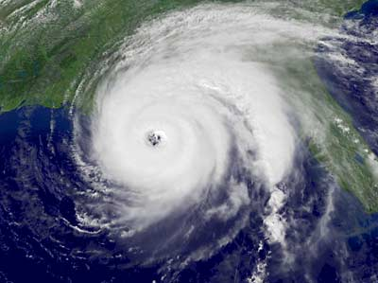

Slide 5
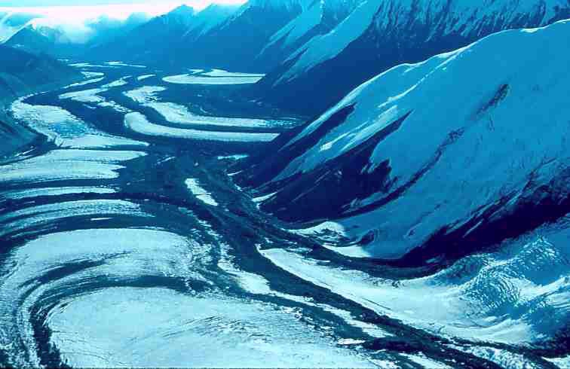

Slide 6
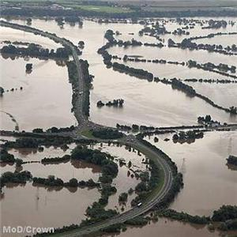

Slide 7
