Slide 1
European Sights
OASE

Slide 2
Schloss Neuschwanstein Who copied this castle?

Slide 3
Roman Bathhouse

Slide 4
Roman Colsseum

Slide 5
London Clock Tower: Big Ben

Slide 6
Louvre: Famous Museum in Paris

Slide 7
Palace of Versailles

Slide 8
Palace of Versailles Gardens

Slide 9
Beaches of Normandy

Slide 10
Berlin Wall

Slide 11
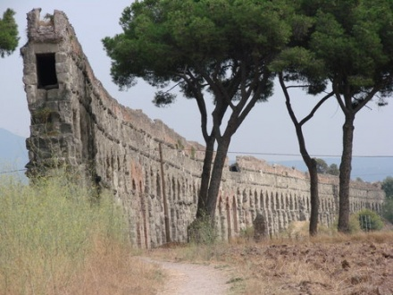
Roman Aqueducts

Slide 12
Running of the Bulls

Slide 13
Pamplona Festival

Slide 14
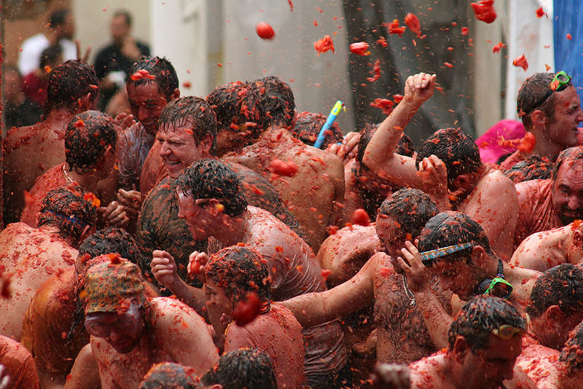
Tomato Festival in Spain

Slide 15
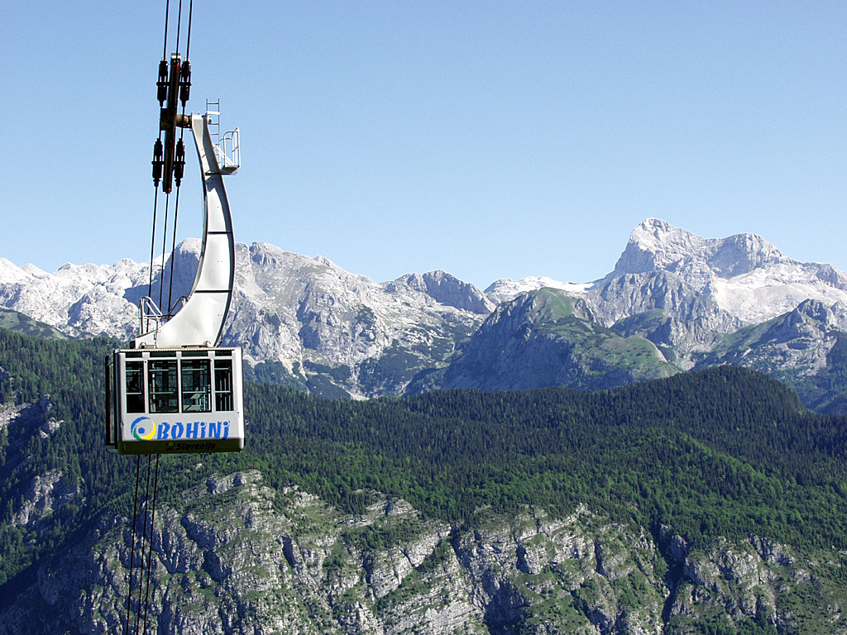
Alps

Slide 16
St. Basil’s Cathedral in Moscow

Slide 17
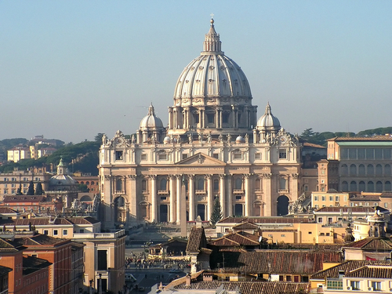
Vatican City

Slide 18
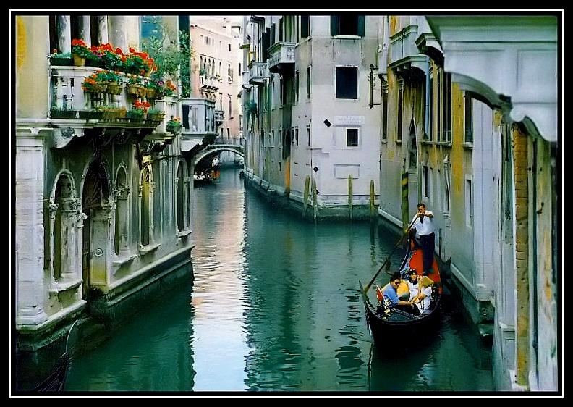
Venice, Italy

Slide 19
Effiel Tower

Slide 20
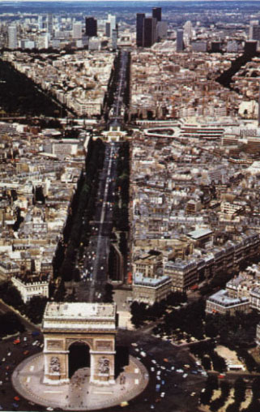
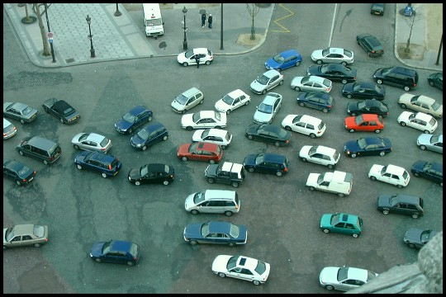
Arc de Triomphe

Slide 21
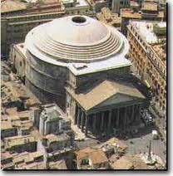
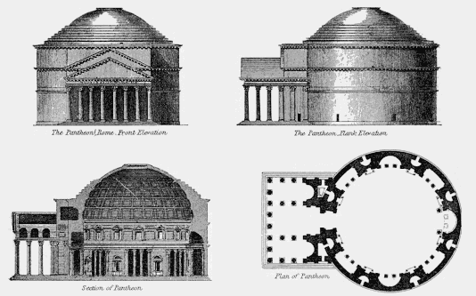
Pantheon

