Slide 1
USA - CANADA
Landforms / Climate / HEI / Regions
Ch. 5-8

Slide 2
Landforms
All major types of landforms exist in US/Canada.
Flat, coastal plain runs along the Atlantic and the Gulf of Mexico. Atlantic Coastal plain and Gulf Coastal Plain.
Appalachian Highlands: Appalachian Mtns.
Interior Plains, Great Plains, Canadian Shield are interior low lands.
West of the plains are the Rocky Mtns.
Canada’s northernmost lands are islands near the Arctic Circle.

Slide 3
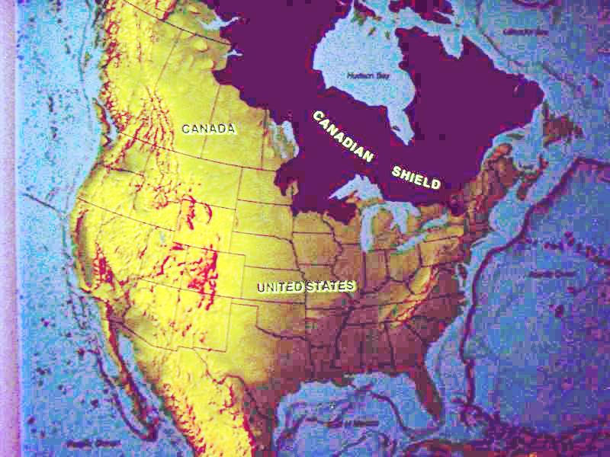
Canadian Shield

Slide 4
Climate
Tundra Climate: Arctic coastlines of Alaska and Canada.
Subarctic Climate: much of the rest of Alaska and Canada.
Highland Climate: Rocky Mtns and the Pacific ranges.
Humid Continental Climate: North central and North east US and much of southern Canada.
Marine West Coast Climate: Pacific coast from northern California to southern Alaska.
Humid Subtropical Climate: Southern states
Mediterranean Climate: Central and southern coasts of California.
Semiarid Climate: Great Plains and parts of Great Basin.
Desert Climate: Southwestern States.
Tropical Wet Climate: Hawaii
Tropical Wet and Dry Climate: Southern Florida

Slide 5
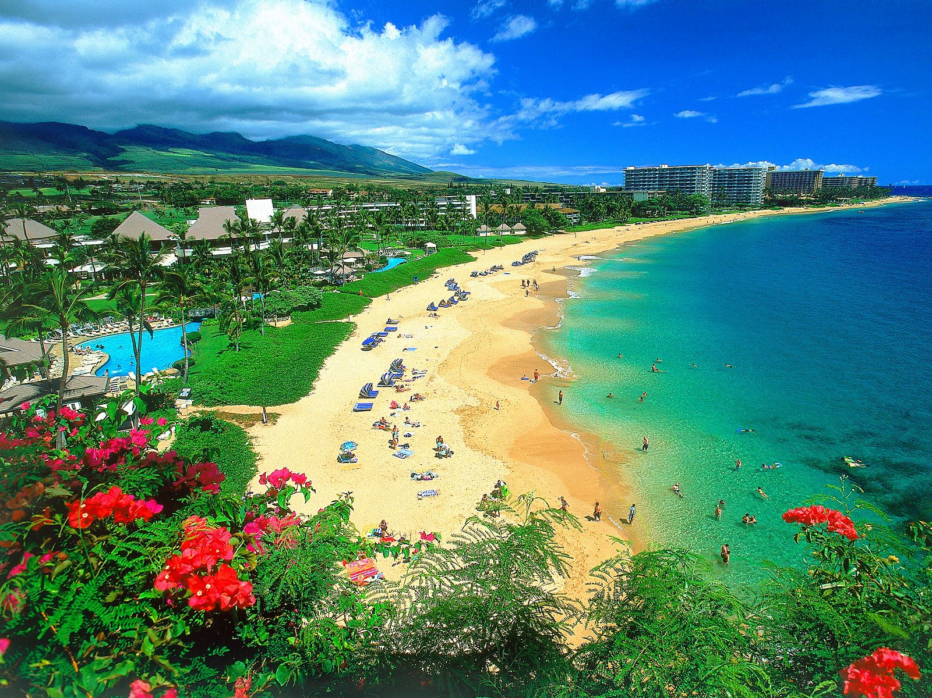
Hawaii – Tropical Wet Climate

Slide 6
HEI Human Environmental Interaction
First people in North America: Nomads- people who move from place to place. They crossed a land bridge (Beringia) that once connected Siberia and Alaska. They hunted mostly; also fished and gathered wild plants.
3000 years ago, agriculture replaced hunting. To grow crops, farmers cut down trees, plowed fields, dug ditches for irrigation and planted corn, beans and vegetables.

Slide 7
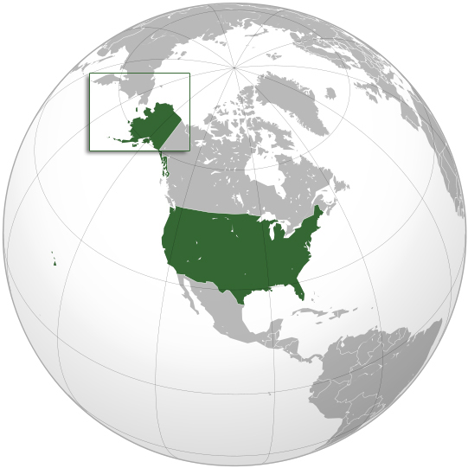
Beringia

Slide 8
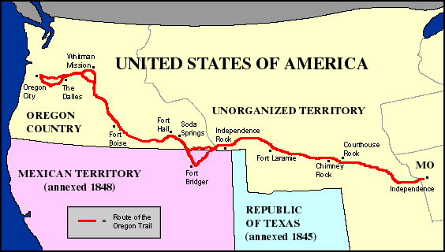
Oregon Trail

Slide 9
HEI con’t
Cities: Landscape, climate, availability of water and natural resources determine where cities were built. Montreal with severe winters has built much underground. Los Angeles, with mild climate, has spread out (469 sq miles).
Distances: Trails (Oregon and Santa Fe) carried goods and people. Inland waterways (Miss and Ohio Rivers). Canals, like Erie canal 1825, linked Great Lakes and Atlantic Ocean. St. Lawrence Seaway, 1950s connect Great Lakes and Atlantic.
Railroads: First transcontinental in US 1869. Trans-Canada railroad completed in 1885.

Slide 10
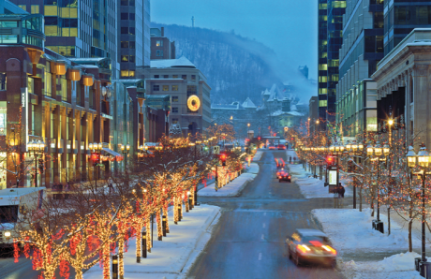
Montreal Winter

Slide 11
Regions
Northeast: Maine, Vermont, New Hampshire, Massachusetts, Rhode Island, Connecticut- New England States.
Mid-Atlantic States: Pennsylvania, New York, New Jersey.
Cold weather and traditional manufacturing industries earned this area the title of “Rust belt”.
Megalopolis: Several large cities grow together. “Boswash” Boston to Washington.
Midwest: 12 north central state. Known as American Heartland because of central location. Flat land with many waterways- know as the nation’s “breadbasket” b/c it produces more food and feed more people than any area around the world.

Slide 12
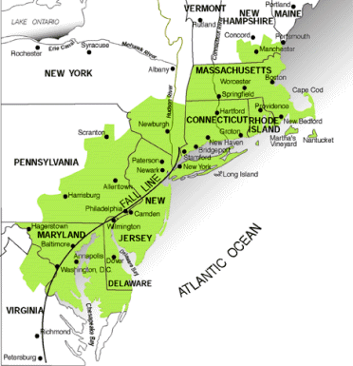
“Boswash”

Slide 13
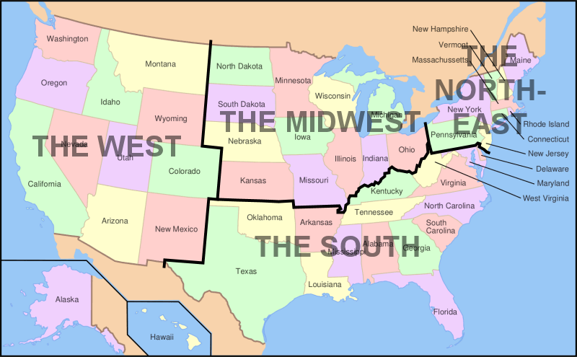

Slide 14
Regions continued
The South: mix of cultures. British, African, Hispanic, Canjuns of French-Canadian origin and Creoles of French and Spanish descent. Also many Hispanics from Cuba.
South is referred to as the “Sunbelt” b/c of its warm climate. Humid subtropical climate- Agriculture was South’s first economic activity.
The West: 13 states from the Great Plains to the Pacific Ocean (includes Alaska and Hawaii).

Slide 15
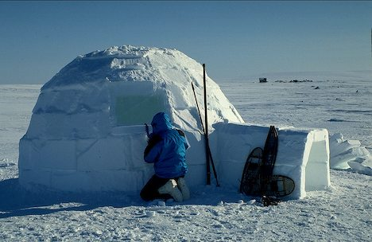
Inuits

Slide 16
Canadian Regions
Atlantic Provinces: Eastern Canada. Prince Edward Island, New Brunswick, Nova Scotia and Newfoundland.
Core Provinces: Quebec and Ontario. Canada’s heartland. 60% of Canadians live here.
Prairie Provinces: Manitoba, Saskatchewan and Alberta. Part of the Great Plains of North America. Produce 50% of Canada’s agriculture.
Pacific Provinces: Western most provinces, British Columbia- lies in the Rocky Mountains.
Territories: 3, Yukon, Northwest and Nunavut (home to Inuits). 41 % of land, little population.

Slide 17
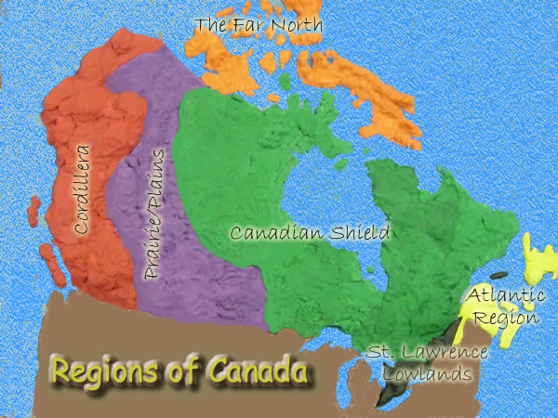
Canadian regions

Slide 18
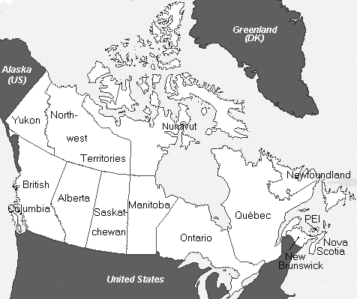
Canada’s Provinces

