Slide 1
Longitude and Latitude

Slide 2
Hemispheres
The earth can be divided into 4 hemispheres
Northern Hemisphere
Southern Hemisphere
Eastern Hemisphere
Western Hemisphere
In which 2 hemispheres is the U.S.A?
In which 2 hemispheres is Australia?

Slide 3
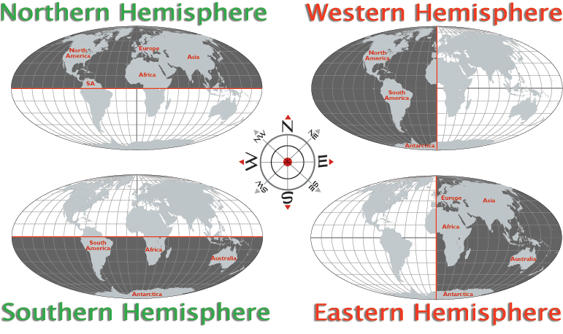

Slide 4
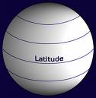
Latitude
0-90 degrees
Horizontal lines

Slide 5
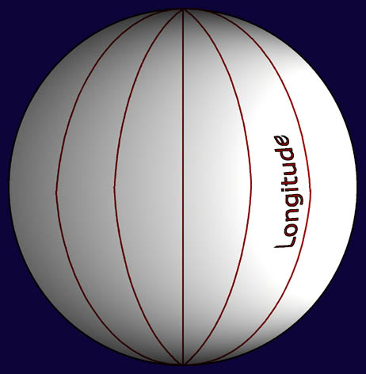
Longitude
0-180 degrees
Vertical Lines

Slide 6
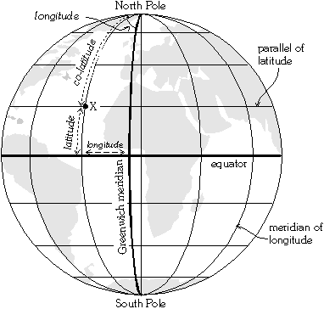

Slide 7
Important Lines to remember …
Latitude – imaginary lines running parallel to the equator used to locate places. (North or South)
Equator 0˚
Tropic of Cancer 23½ ˚N
Tropic of Capricorn 23½˚S
Arctic Circle 661/2˚ North
Antarctic Circle 66½˚South
Longitude- imaginary lines that go around the Earth and through the north and south pole
Prime Meridian 0˚
180˚
Used to measure time zones

