Slide 1
5 Themes of Geography
Fundamental tools for studying the world

Slide 2
LOCATION
Where is it?
Absolute Location
Latitude: °North or °South
Longitude: °East or °West
Atlanta, GA is 33°N, 84°W
Relative Location
Georgia is north of Florida, south of Tennessee, west of South Carolina, and East of Alabama

Slide 3
LOCATION

Slide 4
PLACE
What is it like?
Physical Characteristics
Rivers, Lakes, Mountains, Valleys
Chattahoochee River, Lake Sidney Lanier, Pine Forest
Cultural Characteristics
People, Culture, Language, Religion, Landmarks
Small Town, English, Spanish, Mall of Georgia, Trains

Slide 5
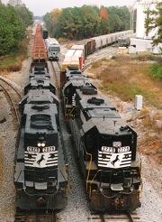
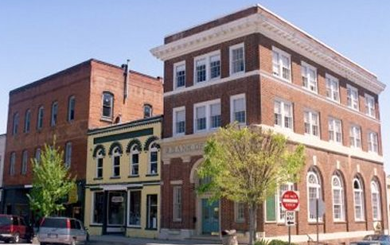
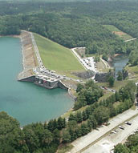
PLACE

Slide 6
REGION
How are places similar of different?
Political Regions
Cultural Regions
Environmental Regions
Landform Regions
Agricultural Regions
How is the Mall of Georgia divided?

Slide 7
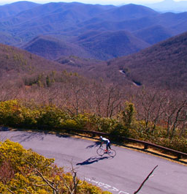
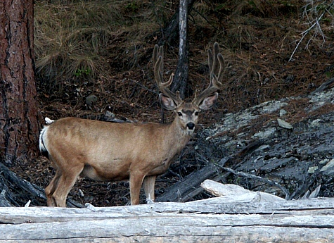
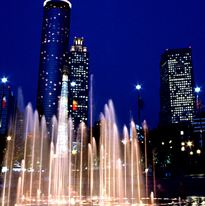
REGION

Slide 8
MOVEMENT
How do people, goods, and ideas move from one location to the other?
Transportation
Trains, Planes and Automobiles
I – 985,
HWY 20
Atlanta Hartsfield Jackson Airport

Slide 9
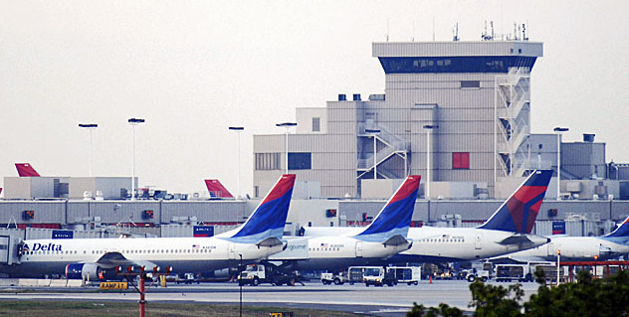
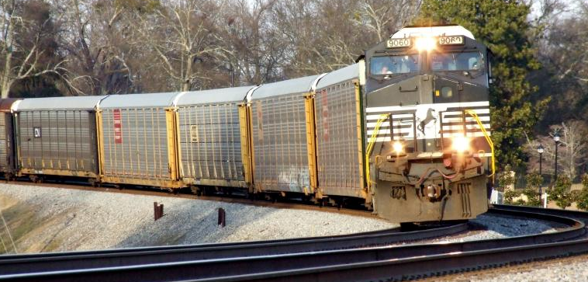
MOVEMENT

Slide 10
HUMAN-ENVIRONMENT INTERACTION
How do people relate to the physical world?
People …
Adapt to their environment
Modify their environment
Depend on their environment
Chattahoochee River
Farming in south Georgia
Interstates

Slide 11
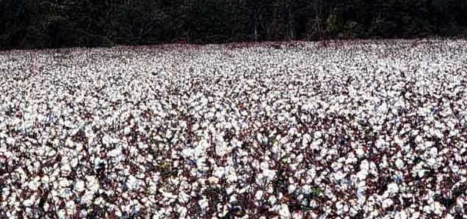
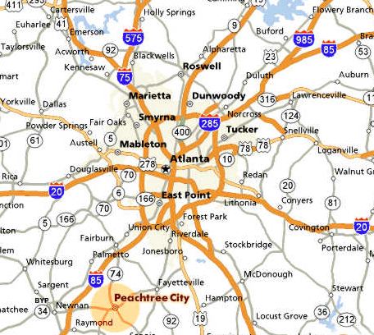
HUMAN-ENVIRONMENT INTERACTION

Slide 12
Map Projections

Slide 18
Map Types
Physical Maps
Political Maps
Thematic Maps
Cartograms

Slide 19
Physical Map

Slide 20
Political Map

Slide 21
Cartogram

