Slide 1
Latin American Culture

Slide 2
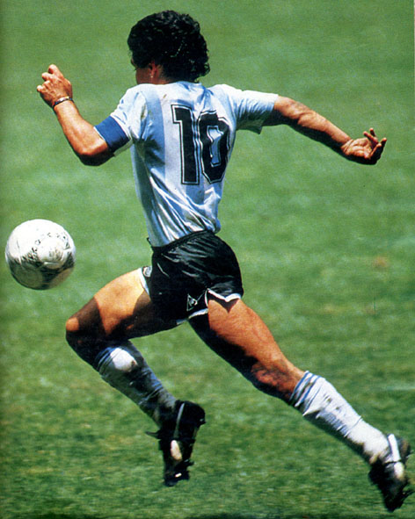
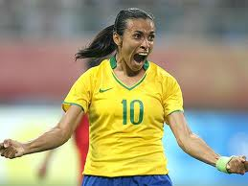
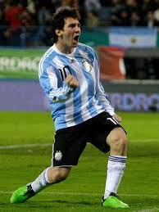
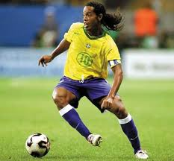
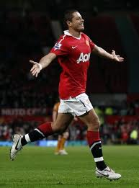
Sports: Soccer

Slide 3
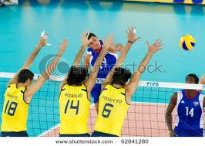
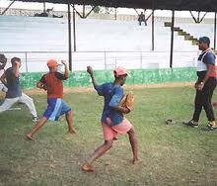
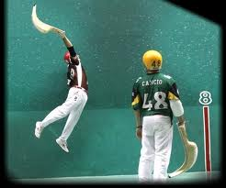
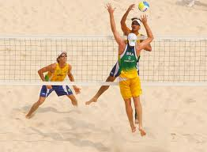
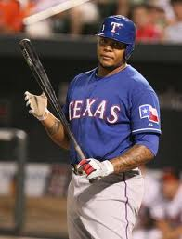
Other Sports: Jai alai, Volleyball, Baseball
Jai alai

Slide 4
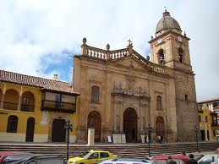
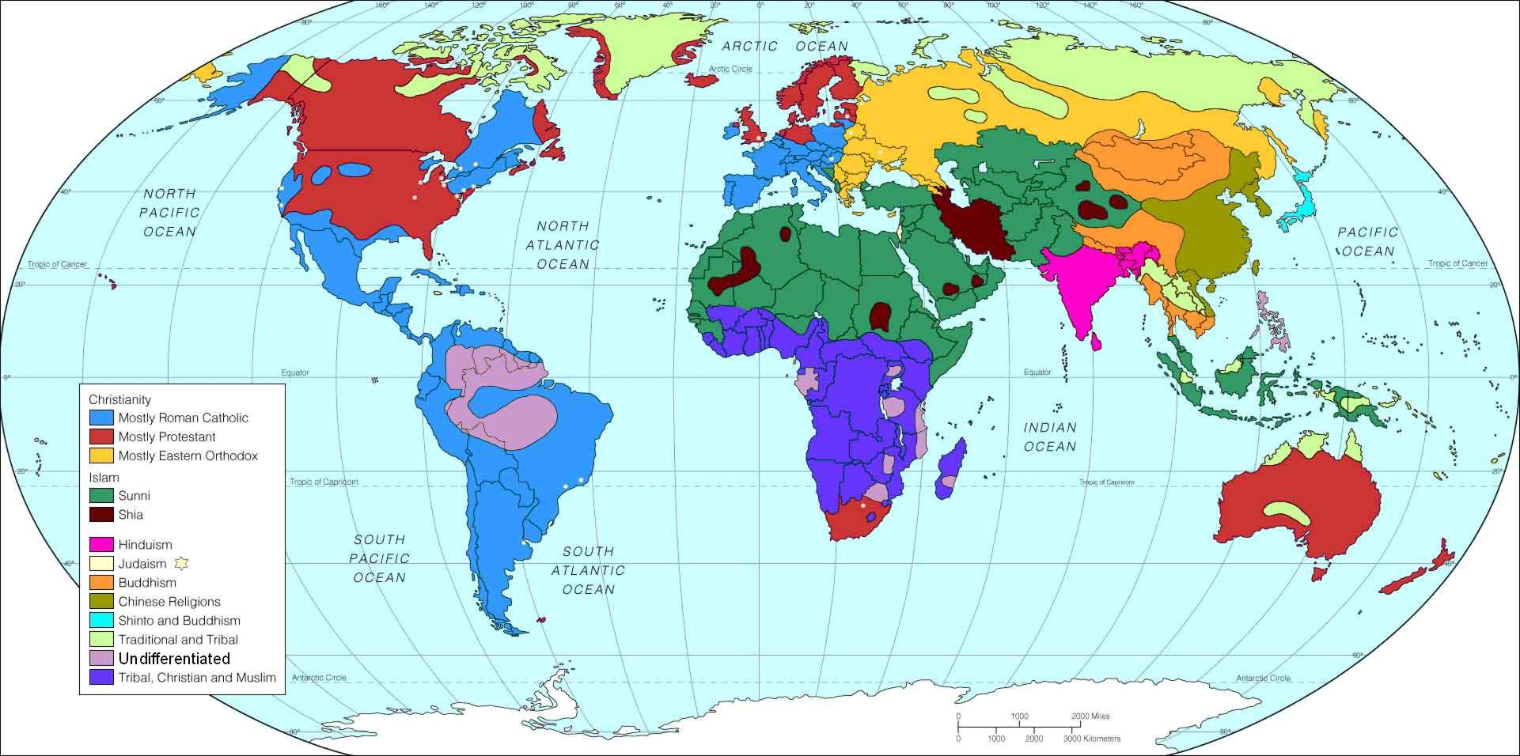
Religions
Roman Catholic, Santeria, Voodoo, and Rastafarianism

Slide 5
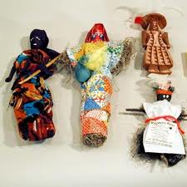
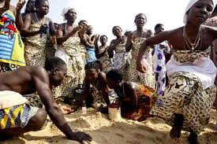
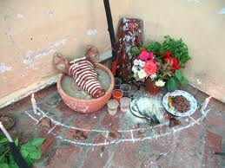
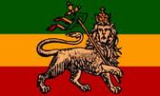
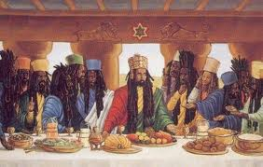
Minor Religions
Voodoo
Santeria
Rastafarianism

Slide 6
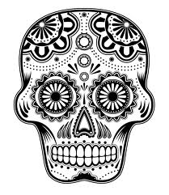
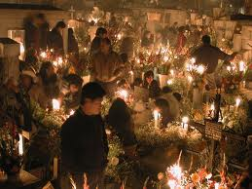
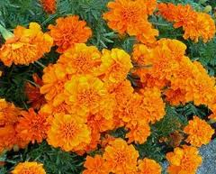
Holidays and Festivals
El Dia de los Muertos
Day of the Dead
Catholic Holidays : All Saints and All Souls
Nov. 1st and 2nd

Slide 7
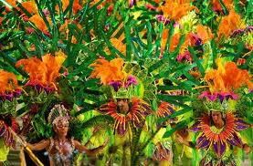
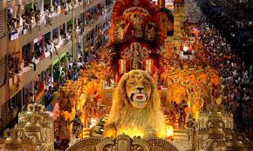
Carnival
Held 46 days prior to Easter
Huge, multi-day party before
Lent (giving up something )

Slide 8
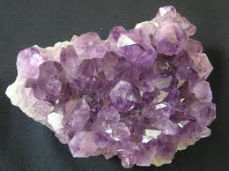
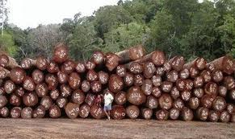
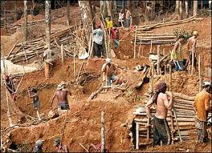
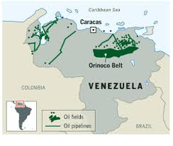
Resources
Minerals in abundance
Tropical/Exotic Hardwoods
Oil fields

Slide 9
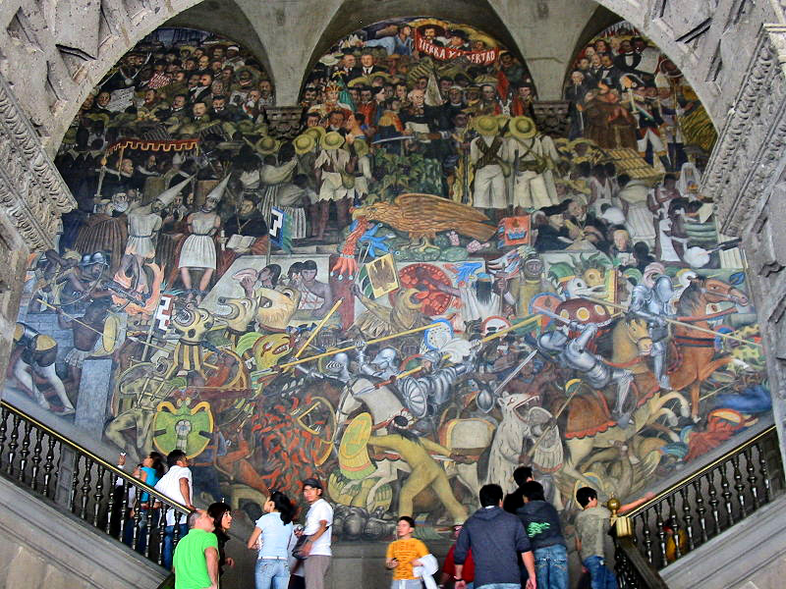
Art and Artists
Murals and Mosaics
Diego Rivera Mural

Slide 10
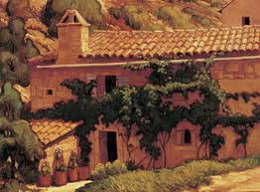
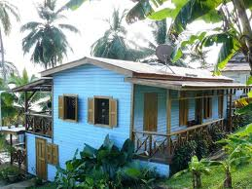
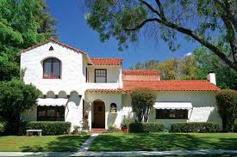
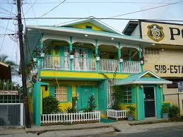
Architecture
Spanish Colonialism
Caribbean Style

Slide 11
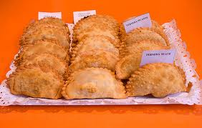
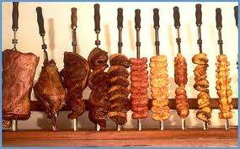
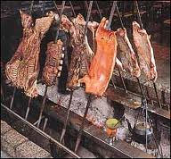
Food
Empanadas
Tamales
Brazilian Churrasco (BBQ)

Slide 12
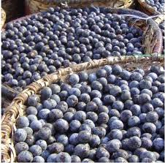
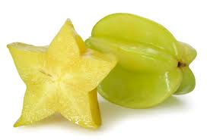
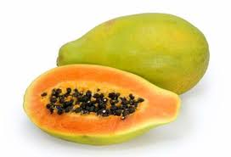
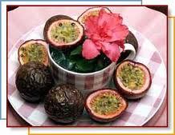
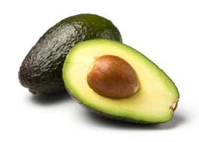
Food Continued
Various Chilies
Star Fruit
Acai
Papaya
Passion Fruit
Avocado

Slide 13
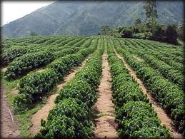
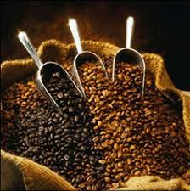
Plantations
Coffee is a cash crop. Plantations found
in Colombia, Brazil, and Costa Rica.

Slide 14
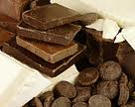
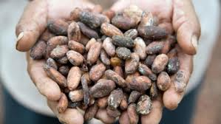
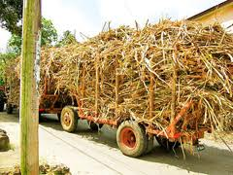
Other Plantations
Banana Plantations: 4th most consumed
Food in the world. Most found in Central
America and Caribbean.
Sugar Cane Plantations: Found in Caribbean
Cacao (Chocolate) Plantations: Brazil and Ecuador

Slide 15
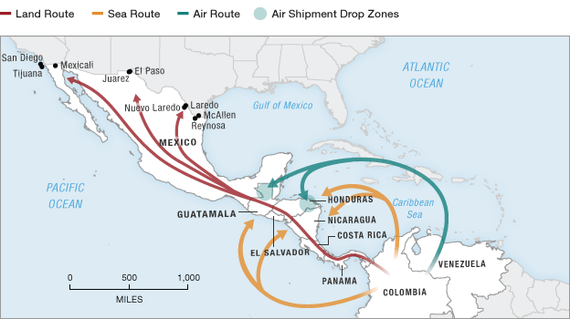
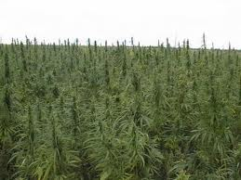
Illegal Drugs
Cocaine Fields
Map showing flow of illegal drugs into USA
Marijuana

Slide 16
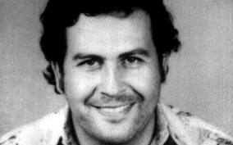
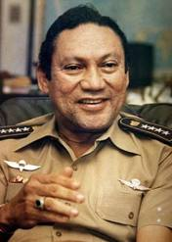
Drug Cartels
Medellin and Cali Cartels were powerful in Colombia.
Currently over 300 drug smuggling organizations.
Leaders are being extradited to the US
Pablo Escobar
Colombian Drug Lord
Manuel Noriega
Panama Dictator
Drugs, Murder, etc

